Slide 1


Finding Sweet Tooth’s home(s)
Capstone project by Jonathan O

Slide 2
Problem
We need to find a location in each borough of New York for new Sweet tooth branches. They would have to be close to tourist attractions but far from other bakeries.

Slide 3
Tourist attractions
The tourist attractions in each borough will be;
Snug Harbor for Staten Island
Museum for Moving Image for Queens
Brooklyn Bridge Park for Brooklyn
Bronx Zoo for Bronx
9/11 Memorial & Museum for Manhattan

Slide 4
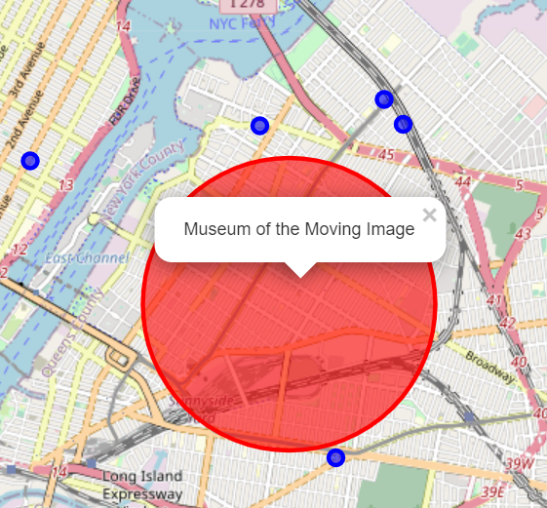
Queens attraction
This map shows that there are not many bakeries in the radius of the tourist attraction in Queens

Slide 5
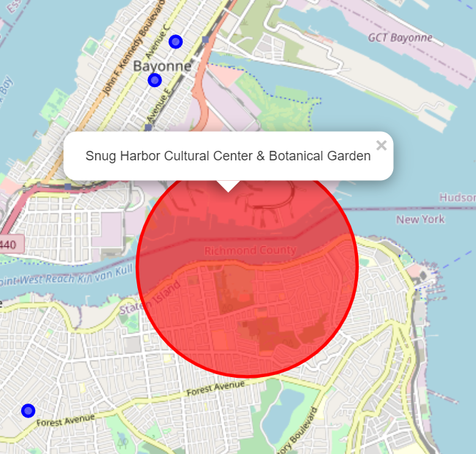
Staten Island Attraction
This map shows that there are not many bakeries in the radius of the tourist attraction in Staten Island

Slide 6
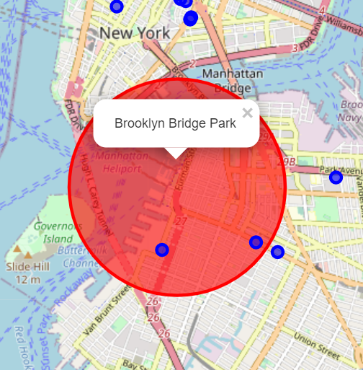
Brooklyn Attraction
This map shows that there are not many bakeries in the radius of the tourist attraction in Brooklyn

Slide 7
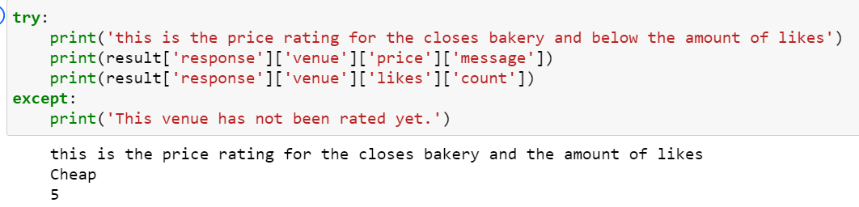
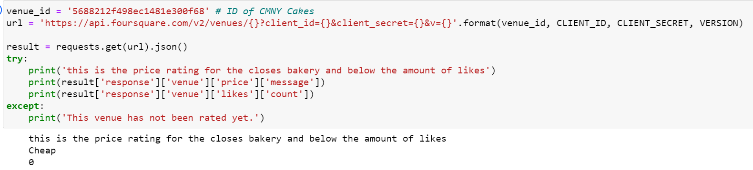
Brooklyn Attraction
There are a couple competitors in the location radius. Lets see some information about theses locations

Slide 8
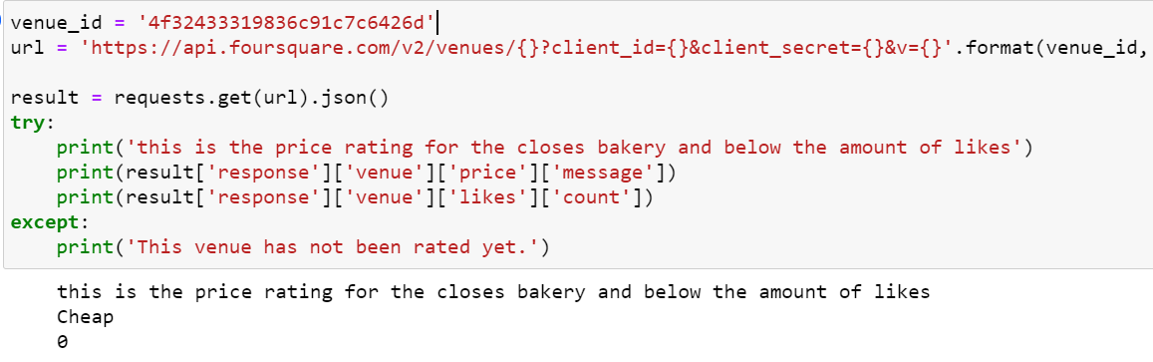
Brooklyn Attraction
From the previous slide and this one we can see that the competition does not have a lot of likes meaning that they are less popular and provides a chance for the branch to come and survive.

Slide 9
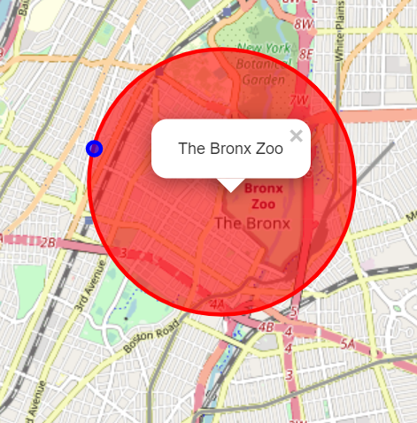
Bronx Attraction
This map shows that there are not many bakeries in the radius of the tourist attraction in The Bronx. The nearest one isn’t classified as a bakery but as a business supplier.

Slide 10
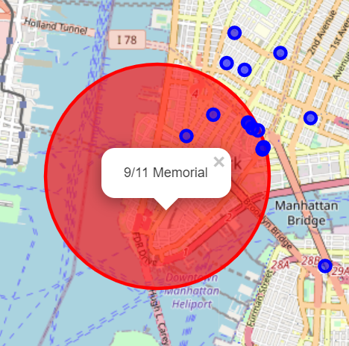
Manhattan Attraction
This map shows that there are not many bakeries in the radius of the tourist attraction in Manhattan. There was a lot of bakeries in the area making it hard for a branch to be placed in this area.

Slide 11
Discussion
From these results we can see that the locations that are selected work well in queens, Staten island and the Bronx. The location selected in Brooklyn had more competition but most of the competition had low ratings so it can still plant a branch and succeed. The branch that is supposed to be planted in Manhattan has a lot of competition so it maybe best to pick another location to open a branch in this borough.

